Slide 1
Planning Alternative Tomorrows with Hope (PATH)
"PATH is a way for diverse people, who share a common problem or situation to align...their purposes...their understanding of their situation and its possibilities for hopeful action...their action for change, mutual support, personal and team development and learning."
Jack Pearpoint, John O`Brien and Marsha Forest (1992)

Slide 2
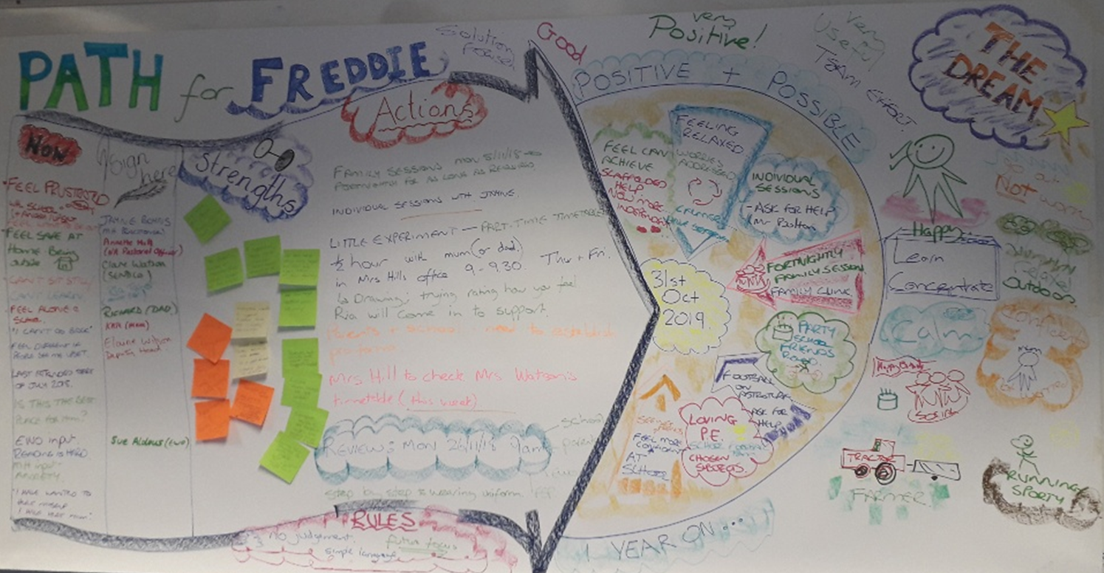
What is a PATH?
STAGES…
NOW
DREAM
GOALS
LONG TERM OUTCOMES
SHORT TERM OUTCOMES
WHO
RESILIENCE
NEXT STEPS
Notes:
PATH originated with Pearpoint, Forest and O’Brien in Canada in the early 1990’s – it is a powerful person-centred planning tool
It uses positive psychology such as the principles of Appreciative Inquiry to support individual and organisational planning
Ideally, there should be a facilitator and graphic recorder AND is usually completed in one session
It is built around a central focus person called a PATHFINDER
The PATHFINDER and those supporting them come together to create a PATH
The group describes the present situation for the PATHFINDER and explore how that feels
The PATHFINDER is invited to share their DREAM – of their highest purpose in life, their positive, desirable future. This includes considering the goals the PATHFINDER wants to work towards and enrol others to work towards as well
Working backwards, long and short term outcomes are identified as well as what and who is needed to achieve these

Slide 3
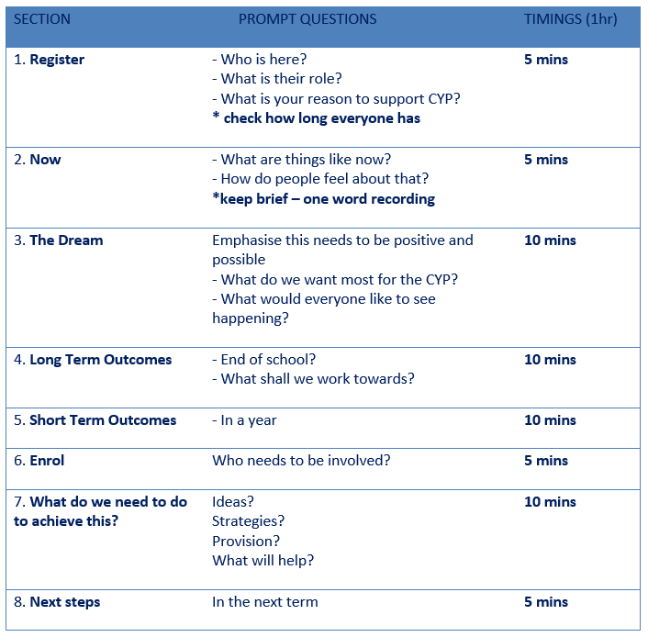
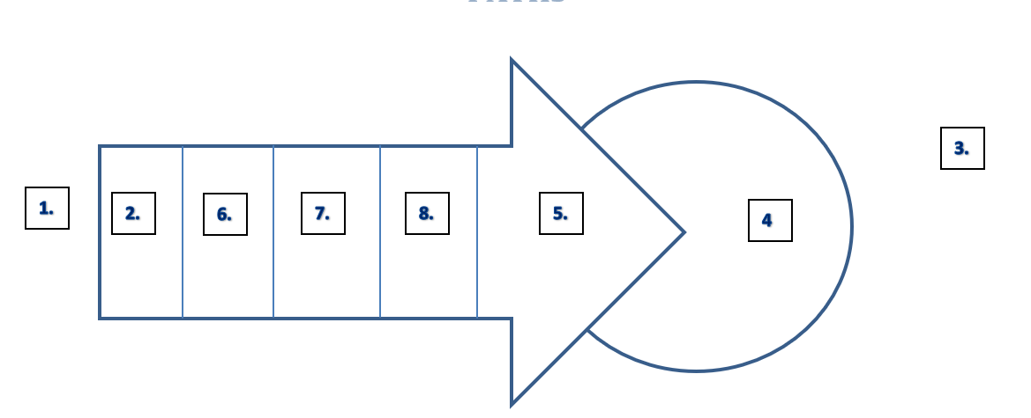
Steps to Creating a PATH

Slide 4
Who could a PATH be used for?
Supporting transitions
CYP who have been excluded/in PRUs
As a structure for Team Around the CYP meetings
As part of the Annual Review process
Planning for school improvement
EPS – when we’re together!
Notes:
When to use PATH
When all involved are feeling little optimism or hope about the future
There is no clear sense of direction for the young person, family or for the professionals
Where team building amongst all involved feels like a priority
Where there is little felt energy for change
Where the young person has severe and complex needs arising from an impairment, disabling attitudes or social circumstances and because of this, it has become hard to imagine a positive future
When not to use a PATH
When needs are not complex and there already is reasonable clarity about where to go next
Where the declared aim of the team is assessment or diagnosis or a statutory SEN or safeguarding review needs to be held
When planning and problem solving are not priority activities
When there has been no preparation for participants

